Slide 1
House price forecasting in California
Presented by Keith kiptui
15 April 2023

Slide 2


CRISP-DM

Slide 3

TABLE OF CONTENTS
01
02
03
04
Business understanding
Problem statement
Data facts and Graphs
Data understanding and preparation
Model output
Modeling and Evaluation of data
Insights
Giving the insights we got from the study

Slide 4
01
Busness understaning
Problem statement: Finding predictions of house prices in california

Slide 5

Facts about the data.
The data was collected from Kaggle.com ,data set from California and had a size of over 25,000 datasets .
The data had all important attributes like; Median house value ,population, number rooms etc…

Slide 6
INTRODUCTION
We will be looking at the insights and findings derived from the California house pricing data.

Slide 7
Cross industry data mining techniques
Problem statement
Data Understanding
Data preparation
modeling
evaluation
communication

Slide 8
02
visualization
Heatmaps ,bar graphs , scatter plot

Slide 9
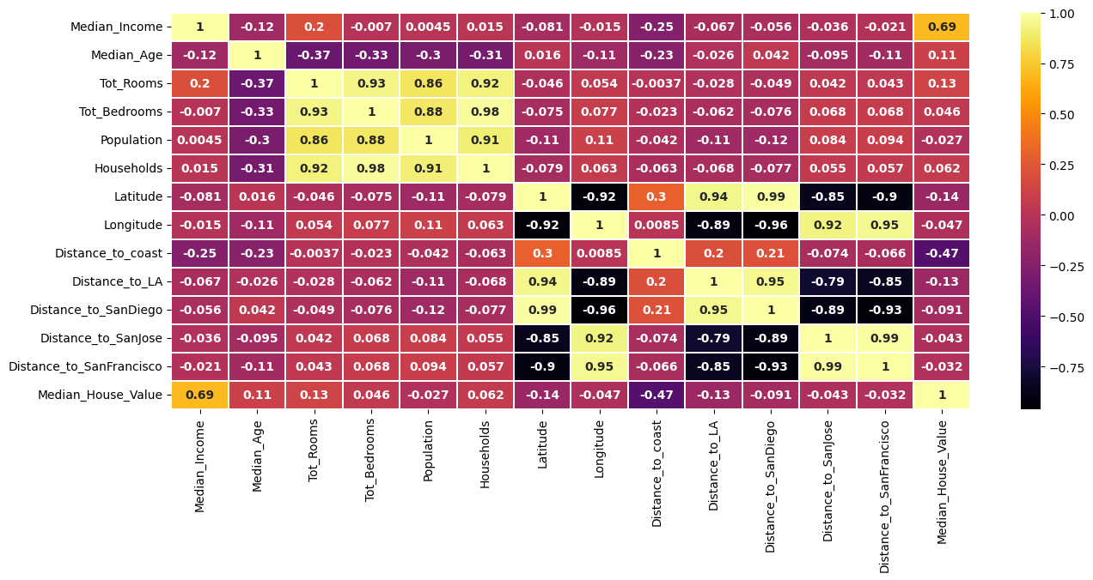
Heatmap
Shows correlation between variables
Independent and the target variables that has high correlation
i.e median house value and median income
This shows high collinearity of the data.

Slide 10
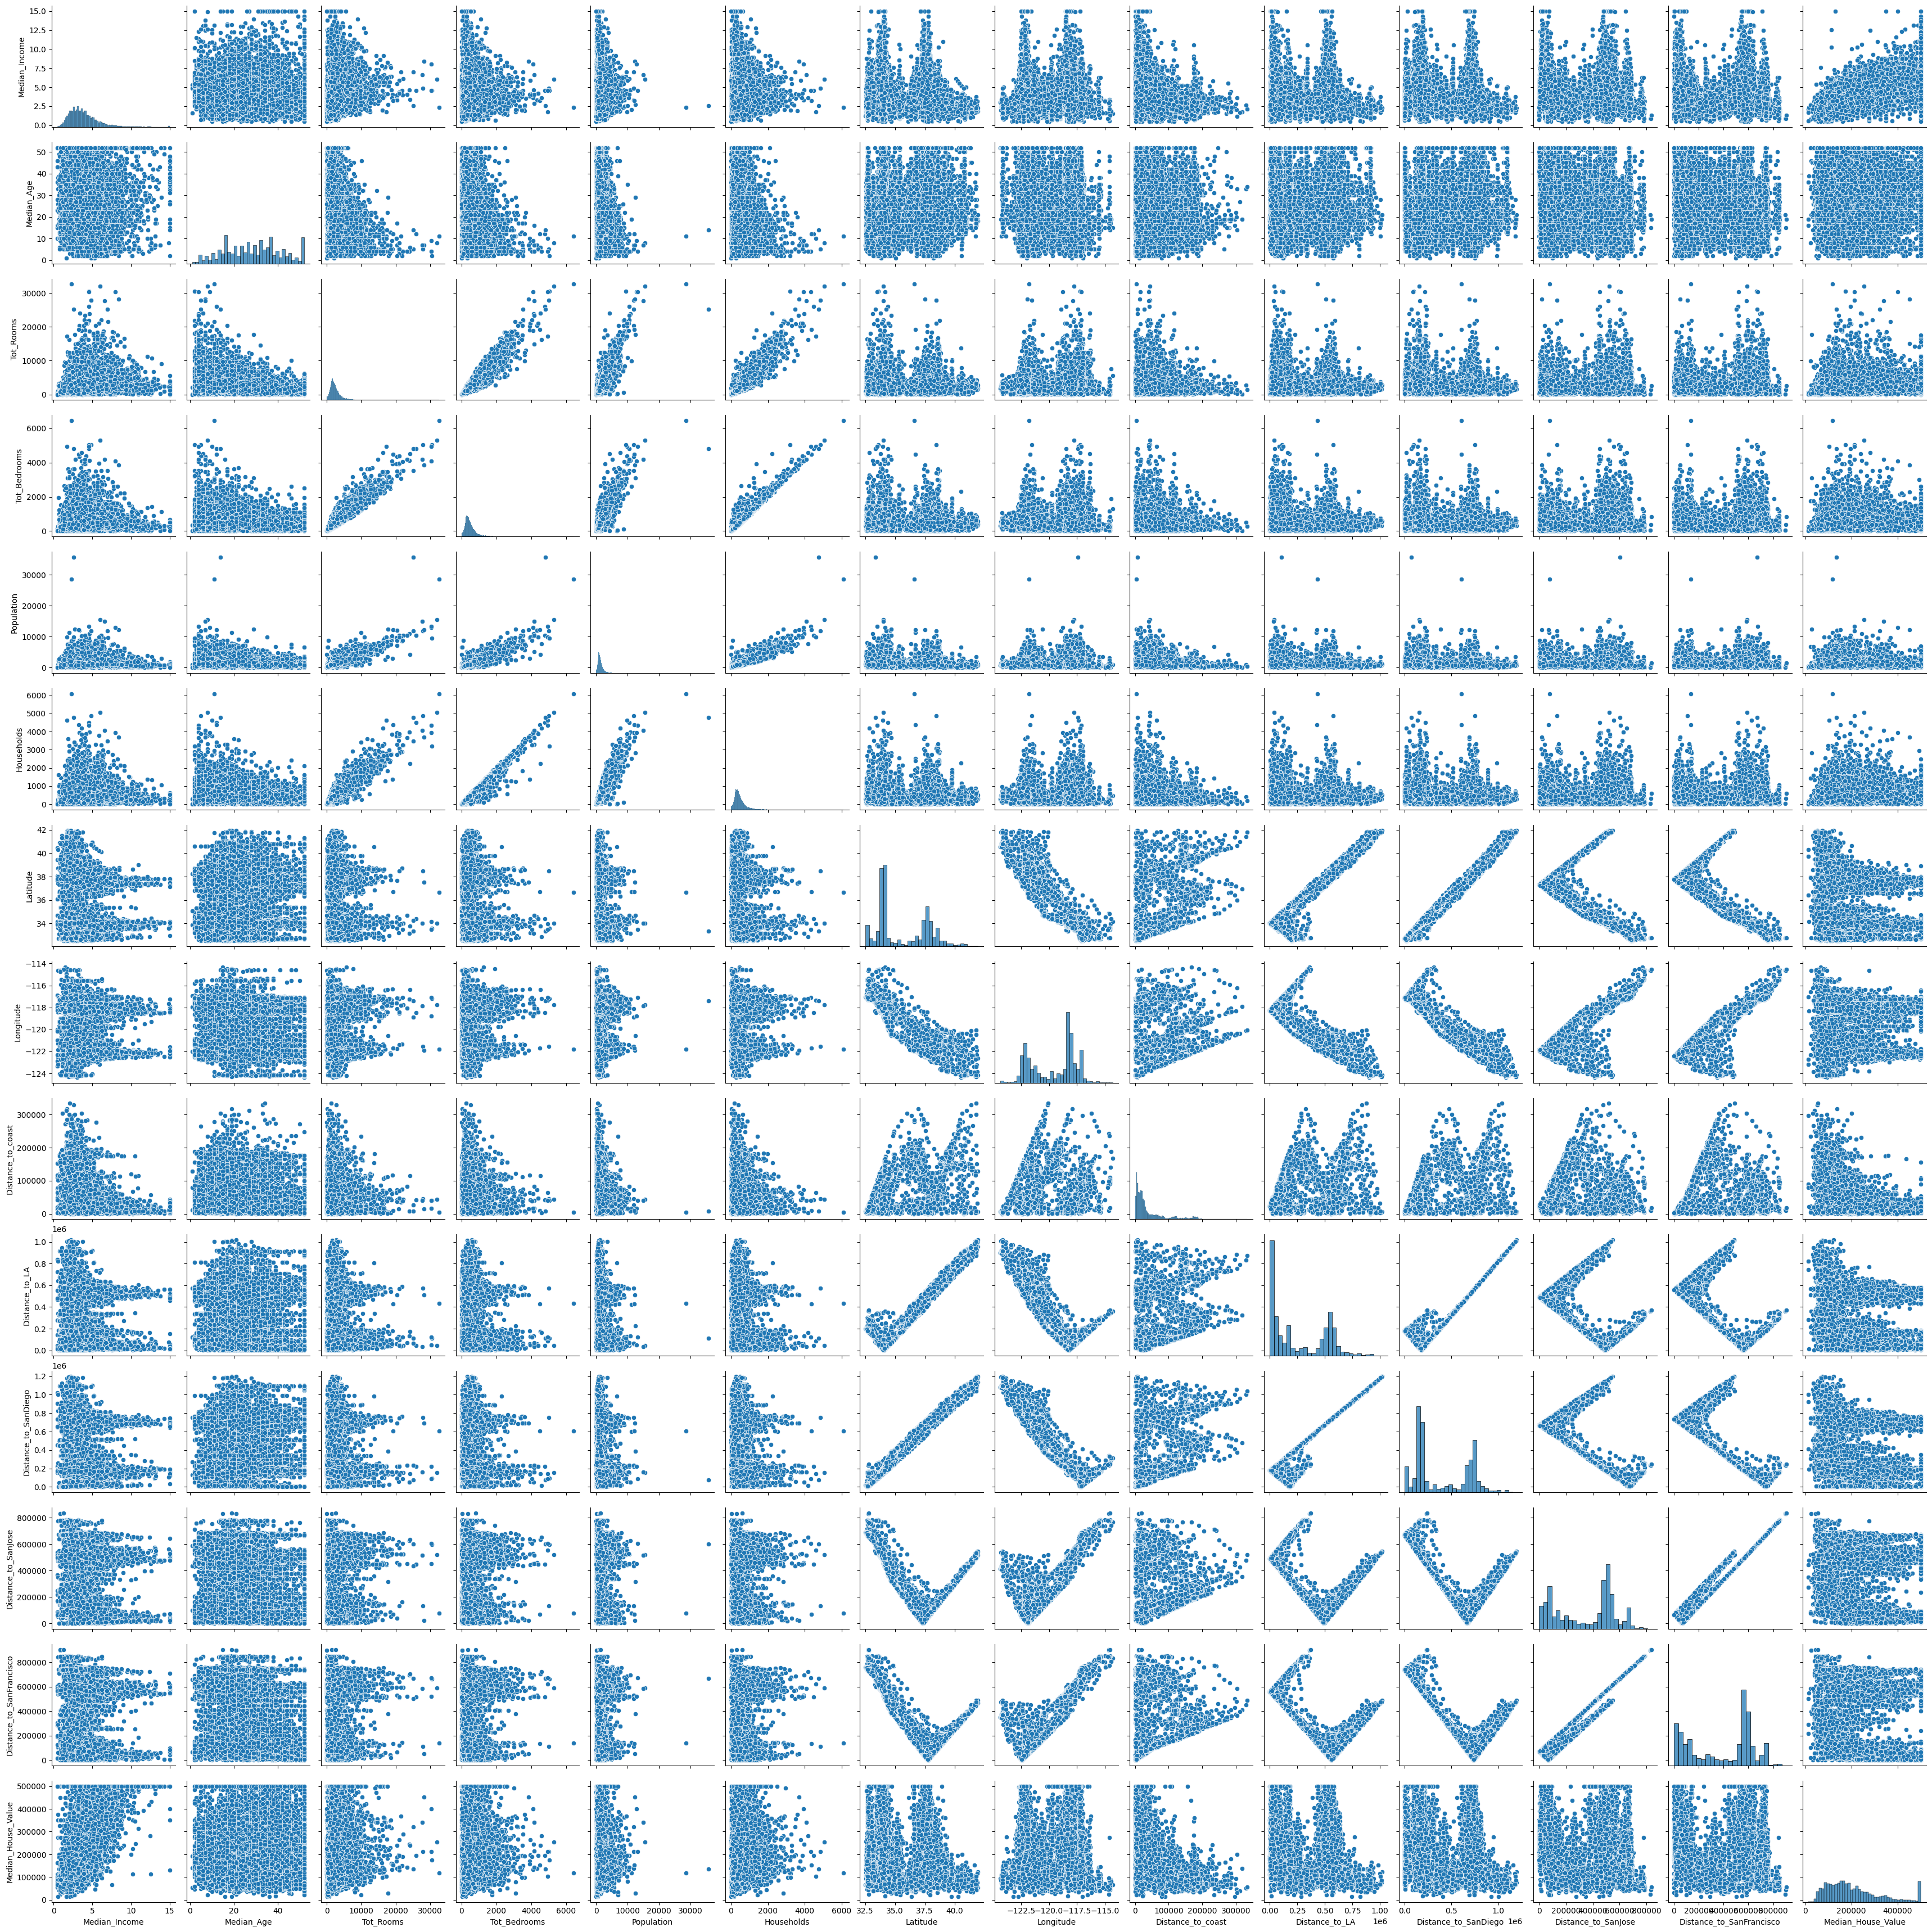


Slide 11
The scatter plot of all dependent and independent variables was to have a visual spread of the data and how they are related to each other.

Slide 12

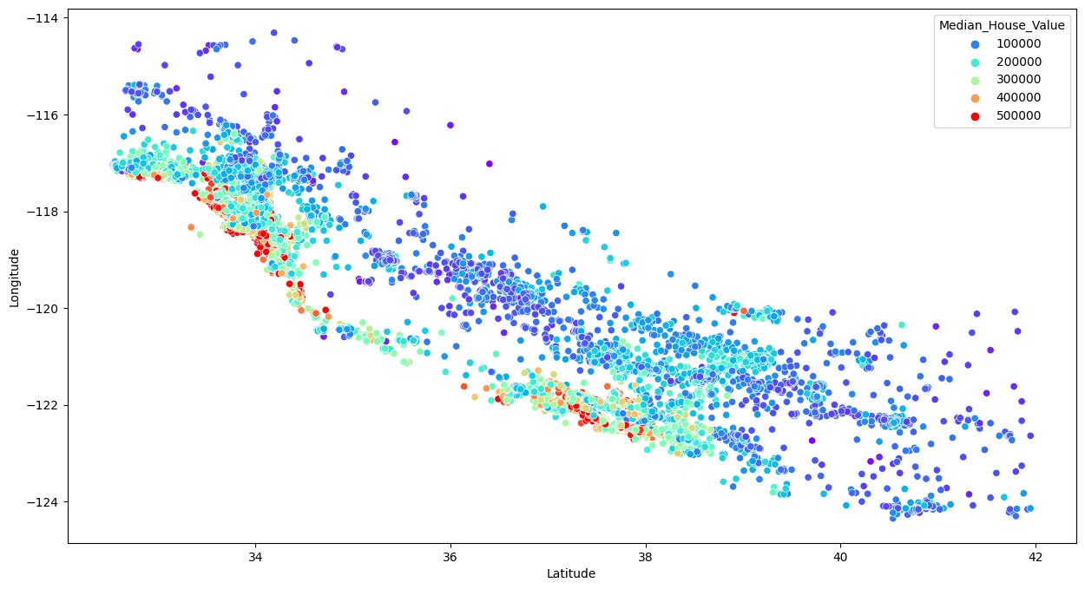
Scatter plot to show how the price is affected by location of the house.
They are either inland or by the beach

Slide 13
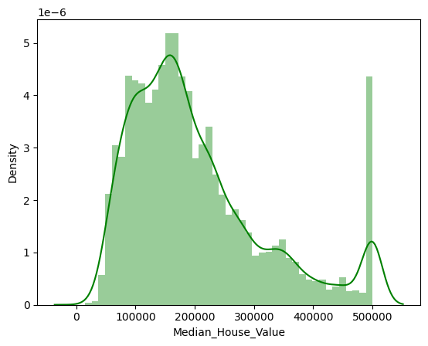
How the Price is distributed
The median_house_value is normally distributed
It is skewed to the right this shows that the frequency payments increase from 0 to 200000 but decrease after words
With an exeption of Sh.500000 that has a rapid increase of households making payments of the same amount.

Slide 14
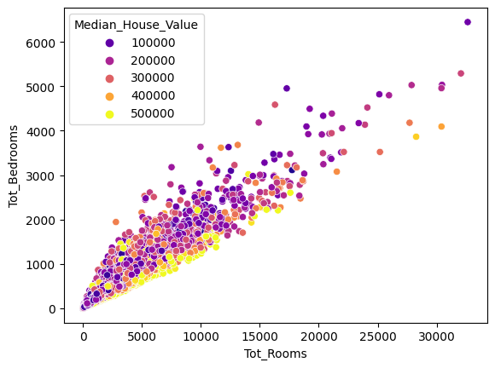
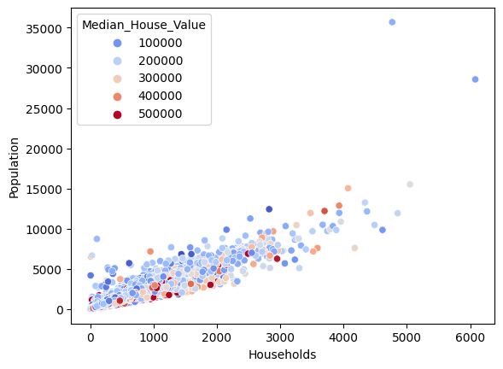
How independent variables relate?
How they affect the price?

Slide 15
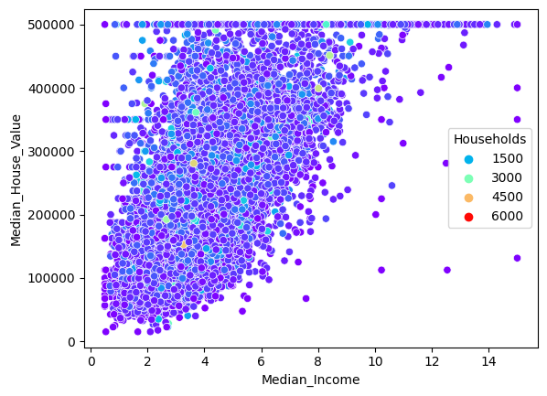
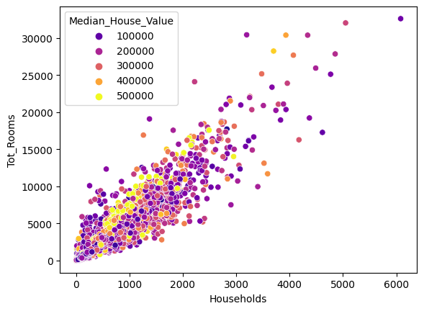
How Income affects price of the House?
How the rooms and Households affect the price of house?

Slide 16
From the scatter plots:
These samples of data have high relationship with each other and with the target variable (Price)
As the households increase the number of rooms required increases hence the prices also slightly increase.
As population increase the household increases leading to more demand of houses
As the Income of homeowners increase the prices of the house also increases

Slide 17

Model Output

Slide 18
Model output
The model was successful and it had an 83% accuracy score which is good and would be fit for doing the prediction
The variance between the predicted price and the actual price was minimal.
The variance between the prices was 10,000
A graph showing the visual difference of prices is plotted on page slide 19.
We tried some sample prediction to show the variance :
Prediction
- predict_1=rf.predict([[50,41,8888,129,589,2323,233,- 123,3456,5678,123,674,7000]])
predict_1 =453910.46
Actual values from column 1
pred=rf.predict([[8.3252,41,880,129,322,126,37.8,-122.23,9263.04077285038,556529.1583418,735501.80698384,67432.5170008434,21250.2137667799]])
Actualvalues=[464977.46]

Slide 19
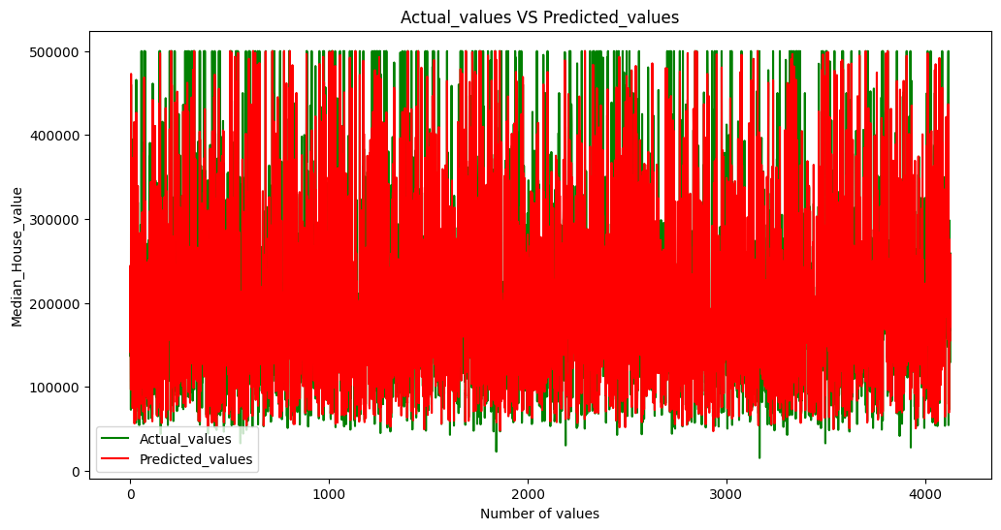
PREDICTED RESULTS

Slide 20
THANK YOU.

